Slide 1

Leave Approval
…

Slide 2
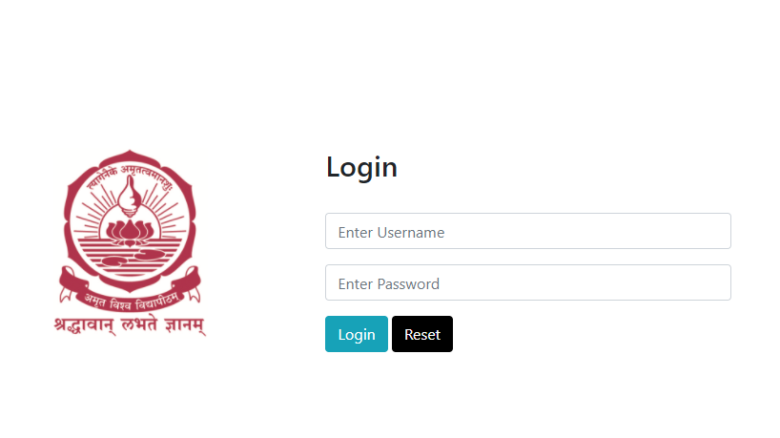
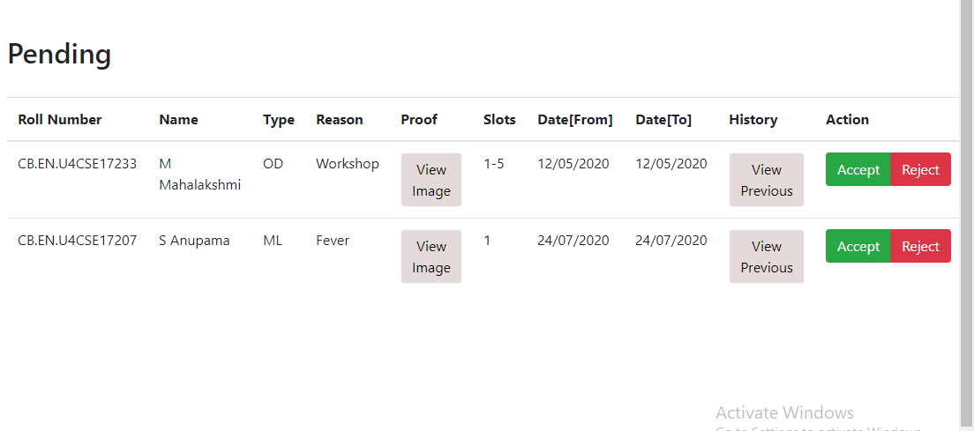
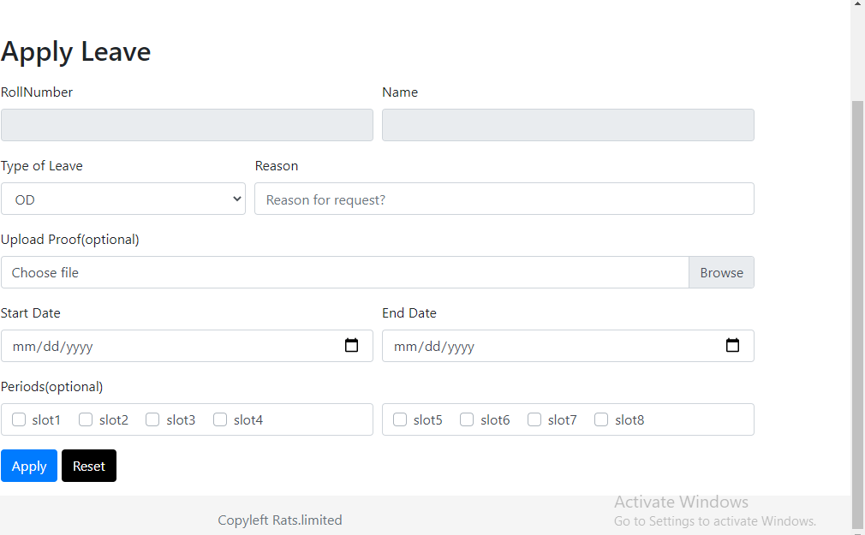
s
LMS
Login To Apply Leave And Approve Leave.
Faculty Can Login To Approve Leave Applied By The Students and Students Can Login To Apply Leave To The Faculty. Separate Login
Based On The Reasons Stated ,and proofs Available Faculty Can Accept/Reject The Leave.
Students Can Apply The Leave, based on their needs and upload necessary proof so that Faculty will have a thought to approve the Leave.

